Slide 1
7FNCE040W
Business Analytics

Slide 2
Supervised Verse Unsupervised Learning
The examples used in this section all fall under the supervised learning domain.
As Each observation of the predictor measurement has an association with the response measurement y.
We fit a model that relates the response with the aim of accurately predicting this response for future observations or better understanding the relationship between the response and the predictors (inference)
Classical statistical methods such as linear regression and logistic regression and other modern approaches operate in the supervised learning domain.
In contrast unsupervised learning describes more challenging situations in which for every observation i, we observed a vector of measurement Xi but no associated response y. It is not possible to fit a linear regression model since there is no response variable to predict. In some sense we are working blind Eg cluster analysis used for market segmentation.

Slide 3
Lecture 1 Bite 2 continued
Open the Advertising data file in spss
(This situ is an inference paradigm)
Management may be considering the following questions
Which media contribute to sales?
Which media generate the biggest boost in sales? Or
How much increase in sales is associated with a given increase in TV advertising?
Notes:
Inference paradigm
Another e.g. how variables such as price , location of store competitor’s price etc may affect the probability of purchasing a particular product?
Some modelling could be conducted for both inference and prediction – e.g. Real estate eg- how much EXTRA is a house worth if it overlooks a lake? - = inference problem but if are interested in predicting the value of a given its characteristic is it over or under priced? == Prediction problem.

Slide 4
Inference vs Predictions
Linear models allow for easy interpretation – may not lead to accurate predictions
Non – linear models approached considered later in the module can potentially provide more accurate predictions for Y ( but can be less interpretable)

Slide 5
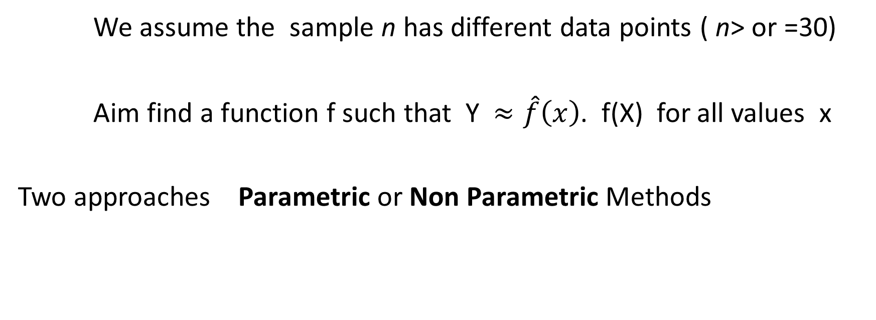
How do we estimate f
We assume the sample n has different data points ( n> or =30)
Aim find a function f such that Y $≈\hat{f}\left(x\right)$. f(X) for all values x
Two approaches Parametric or Non Parametric Methods

Slide 6
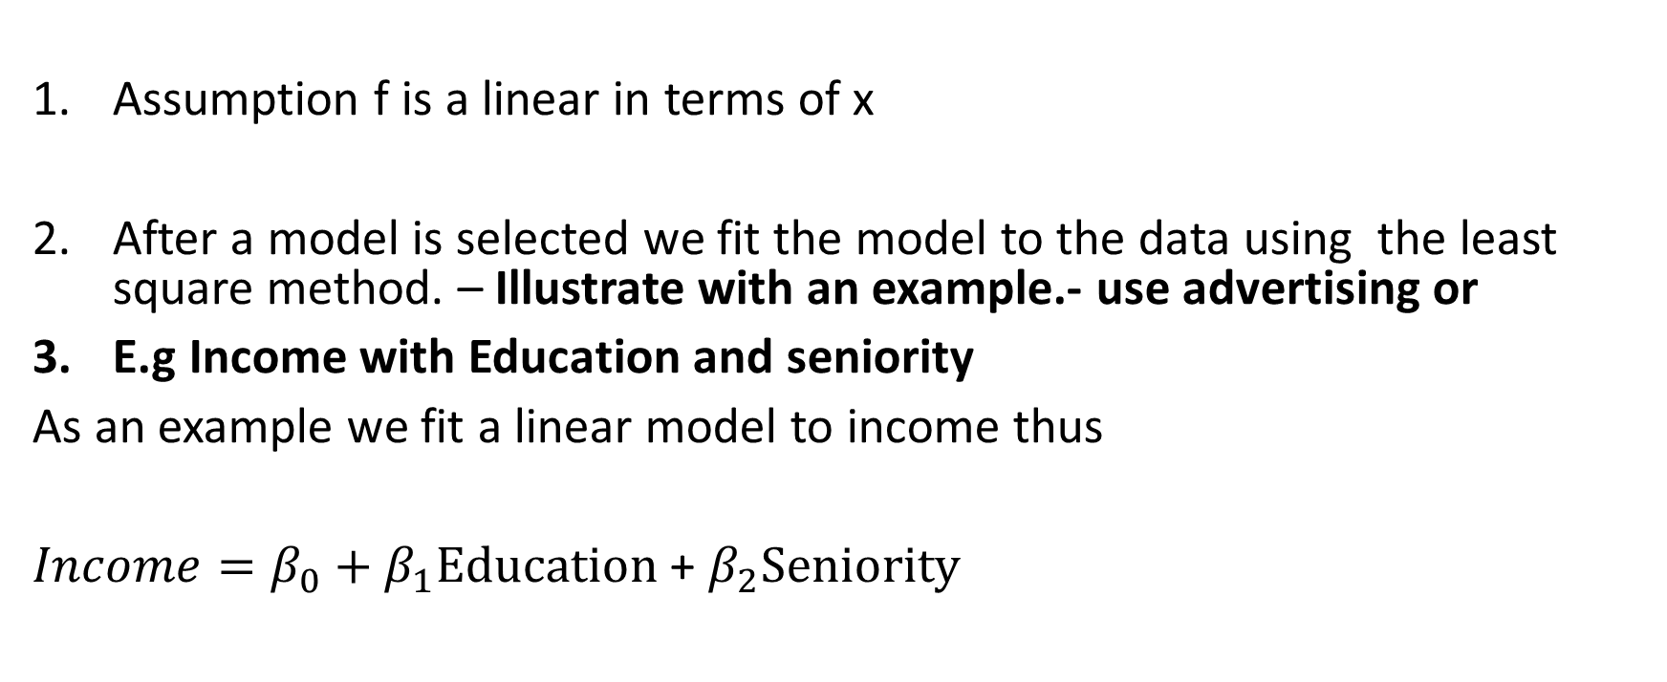
Parametric Methods 2 step model-based approach
Assumption f is a linear in terms of x
After a model is selected we fit the model to the data using the least square method. – Illustrate with an example.- use advertising or
E.g Income with Education and seniority
As an example we fit a linear model to income thus
$Income=β_{0}+β_{1}Education$ + $β_{2}Seniority$

Slide 7
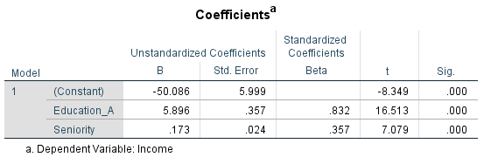

Output from spss $Income=β_{0}+β_{1}Education$ + $β_{2}Seniority$ Income = -50.08 + 5.89Education + 0.173 Seniority

Slide 8
Income data is fitted to a linear equation. observations are displayed in red. Slightly less positive relationship between seniority and income. Model is fitted using the line of best fit (least square method)

Slide 9
Using SPSS or Excel Build this model
Data is stored in week 1 document as an excel file.
Write the equation on this slide once you have built the model.

Slide 10
Non- Parametric Methods.
These methods do not make explicit assumptions about the functional form of f.
Method seeks to find an estimate of f that gets as close to data points as possible without being two rough or wrigley.
Advantage of this method is it avoids the assumption of a particular function form of f. It assumes to accurately fit a wider range of possible shapes for F.
Disadvantage this method does not reduce the problem of estimating as to a small number of parameters. A very large number of observations is required in order to obtain an accurate estimate for F.
These methods will be considered later.

Slide 11
A rough thin spline fit to the Income data This fit makes zero errors on the training data.
Notes:
Note the non parametric fit has produced a remarkably accurate estimate of the truth f as shown in the yellow figure.
A a thin plate spline is used to estimate F. This approach does not impose any pre specified model on f. instead it attempts to produce an estimate for F that is as close as possible to the observed data see yellow graph. However this is an example of overfitting the data. It is an undesirable situation because the fit obtained will not yield accurate estimates on new observations that were not part of the training data set. We will discuss these at a later stage.
. The resulting estimate fits the observed data perfectly. However this spline fit is far more variable than the true function F. The resulting estimate

Slide 12
Trade-off Between flexibility and interpretability, using different statistical methods.
In General, as the flexibility of a method increases, it's interpretability decreases.
Notes:
Why use a more restrictive method instead of a flexible approach?
Reasons include that we may mainly be interested in inference
We may want restrictive models as they are much more interpretable. E.g.the linear model may be good choice since it's easy to understand the relationship between Y and X1, X2 …..XP.
In contrast very flexible approaches such as spine's and the boosting methods can lead two such complicated estimates of x that it is difficult to understand how any individual predictor is associated with the response. Note the least square regression model is relatively inflexible but quite interpretable.

Slide 13
Lecture 1 Bite 2
We will explore the linear models in greater details next week
For practice you may wish to explore the data set on income to find a simple or multiple regression model. Which we can discuss next week

